Slide 1
Pavement Roughness Estimation
Justin Kuennen, Greg Starr, Christian Royston,
Joe Van Treeck, Kyle Eckrich, Tanner Dempsay

Slide 2
About project
The goal of our project is to develop an Android application for pavement roughness measurement
Get real-time measurements of International Roughness Index while driving
Store route data in remote database/server system
Characterize solution in comparison to “Class 1 profilometer” device
Notes:
By Joe Van Treeck

Slide 3
Requirements
Functional
Frontend:
Android-based application
Interface that is easy to use while driving
Calculate IRI (International Roughness Index) using accelerometer data acquired by the application
Accurately measure pavement roughness using the quarter-car model
GPS showing users current location and path taken
Backend:
Database of previous paths and measurements
Realtime IRI calculations streaming to app users
Based on NodeJS framework

Slide 4
Requirements, cont.
Environmental
Java-based Android application
Access accelerometer data of the device connected to the windshield of a vehicle
NodeJS-based server
Database to store information collected by application
Economic
Android based device is required for application testing
Physical server to send information used for IRI calculation
App is compatible with wide range of Android devices

Slide 5
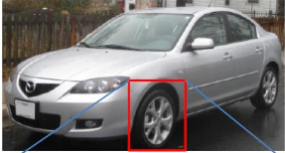
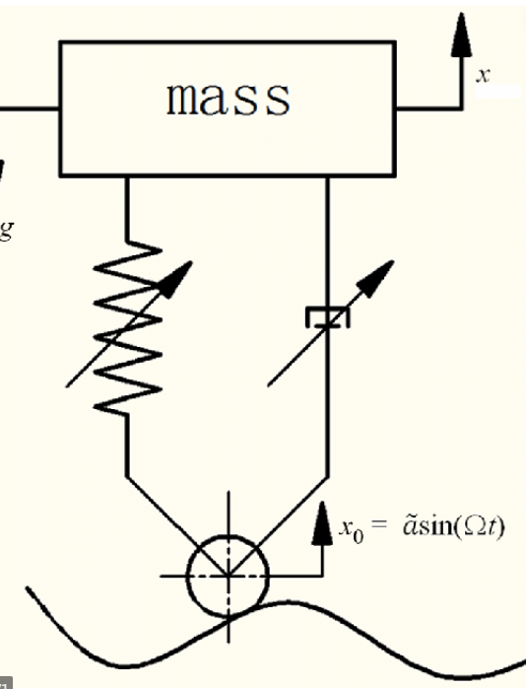
Standards
International Roughness scale (IRI)
Quarter car model
Android Design Guidelines
Use for UI design
Core app guidelines
Agile Standard for Scrum
Use for development cycle

